Slide 1

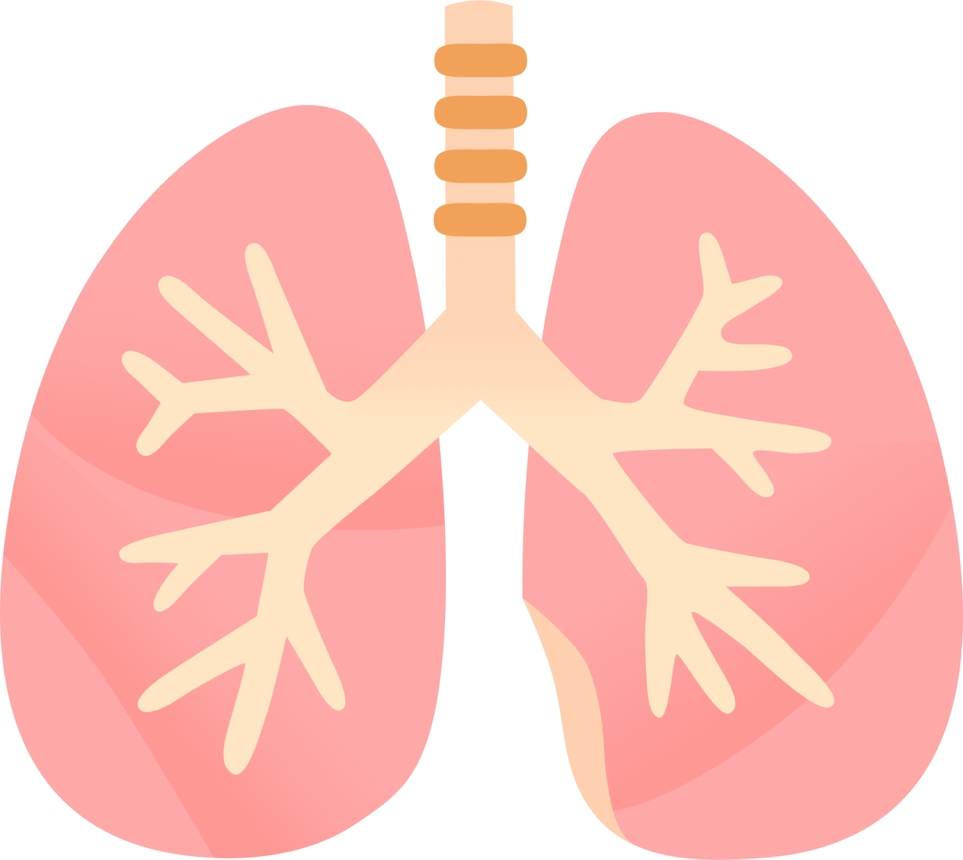
LUNG SOUND RECORDER
Team: Quad-Core Squad
By: Karthik, Aryanil, Anurag, and Adithya
Professor: Abhishek Srivastava
TA: Santhoshini
Week-6

Slide 2
New stethescope setup

Slide 3
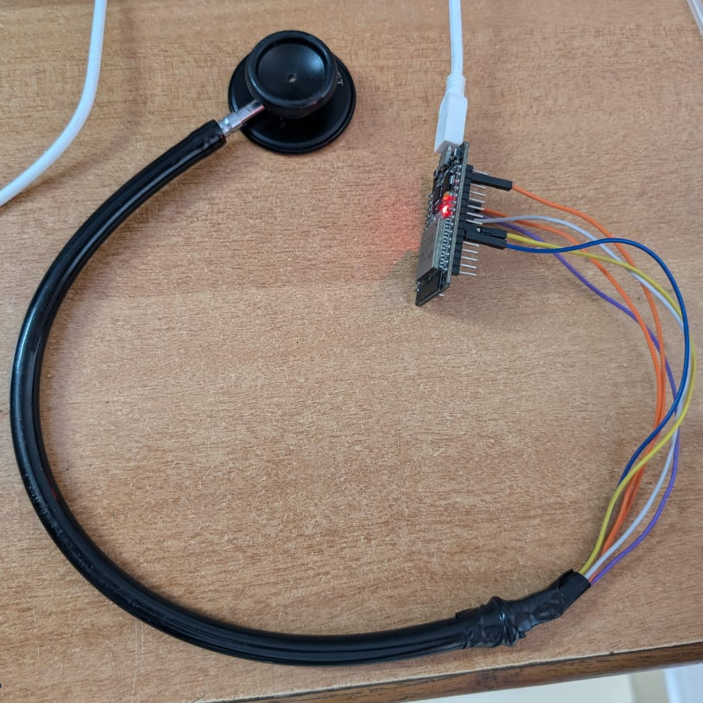
Setup
ESP32
Replaced the old stethoscope with a new one.
Tightly bound electrical tape around both wires and INMP-stethoscope junction to completely cut out air flow
linear
Stethoscope head
Electrical tape
INMP441

Slide 4
Code Used
The code used for recording can be found at https://github.com/AryanilPanja/lung_sound_recorder/blob/main/mic_recording_github.ino

Slide 5
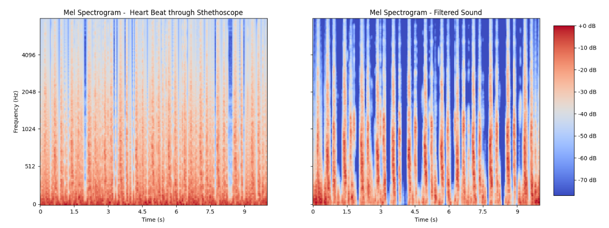
Recorded and filtered sound

Slide 6
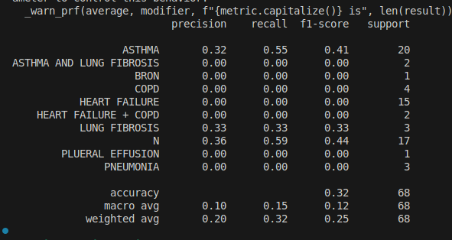
Extending the SVM model
We have extended the SVM model to take in more data points
Some challenges faced were increased size in arrays and low data set inputs

Slide 7
Python Script
We generated a python script for tokenizing the list of files in the dataset for obtaining the labels for each files(we have 13).
We are splitting by '/' to get the file name, then by '_' to get the first part. We finally split by ',' and then convert the words to upper case to get the list of labels.

Slide 8
Further Process with LSTM neural network
Last time I made a sanity check with this model and checked the accuracy and working of the model implemented
This time I tried to scale the model into a proper model where it will detect different anomality's and classify them

Slide 9
Issues faced...
In Jupyter notebook , I faced a new dependency issue which I am trying to solve.
The model isn't running because of the dependency issue of "_sqlite3" as forementioned.

Slide 10
Further steps on LSTM
I am trying to figure out the working of the model better by remaking already tested models to deepen my understanding
After this I will try to remake the model for heart/lung sound again for classification

Slide 11
Next Steps
Generating data points using the new setup
Improving accuracy of models using data preprocessing and parameter tuning
Recording lung sounds

